Slide 1



Build your own R package
Junbin Zhao
Feb 11, 2020

Slide 2


Who?

Slide 3


Not ready?
A simple example function
“std.error ()” in the package “plotrix”
Be able to write a function → Ready!
$$Standard error=\frac{Standard deviation}{\sqrt{Sample size}}$$

Slide 4
Why?
Most efficient way of sharing your code
Easy to spread (visible to more people)
Easy to understand (good documentation)

Slide 5
When?
Code worth to share!
Signs:
Someone asks to share your code
Use a function several times yourself

Slide 6
How?
Essential Tools:
Rstudio
Github (https://github.com, get a free account)
R packages: “devtools”, “roxygen2”
Supportive softwares:
Rtools (https://cran.r-project.org/bin/windows/Rtools/, for Windows)
Git (https://git-scm.com/downloads, for version-control)

Slide 7





Basic concept
CRAN

Slide 8
The 5 simple steps

Slide 9

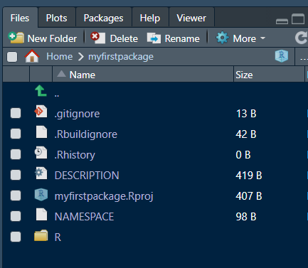
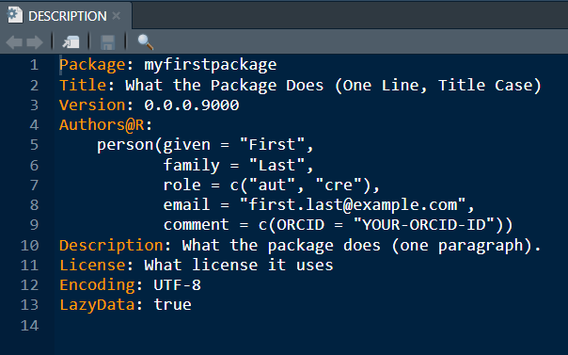
Step 1: create a project
Key items:
“R” folder: hold your R function scripts
“DESCRIPTION”: metadata

Slide 10
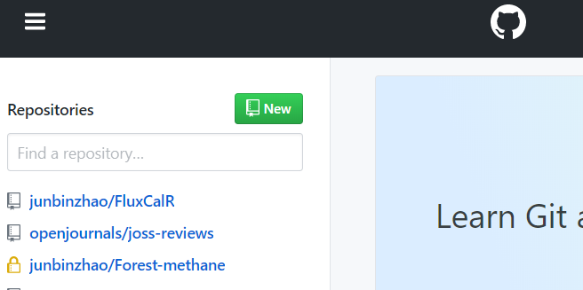
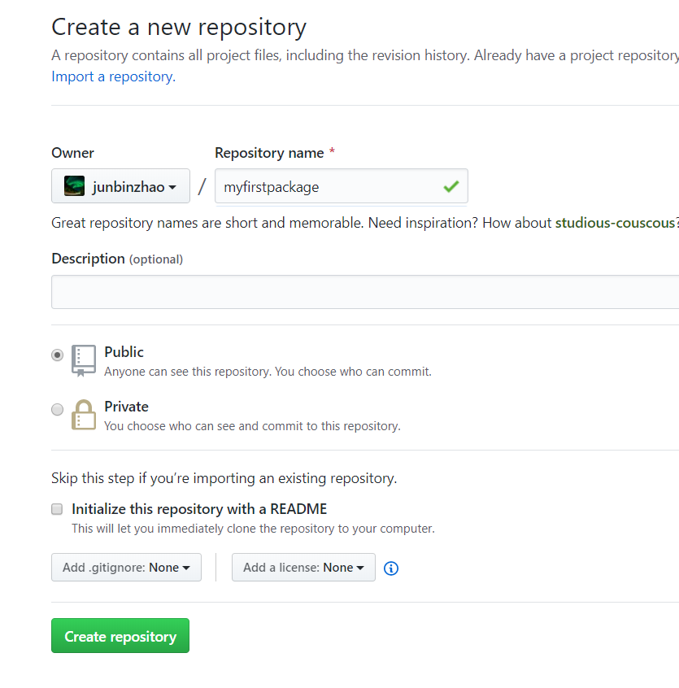
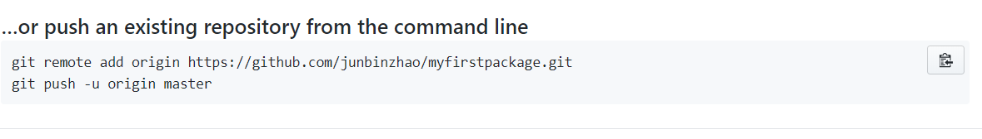
Step 2: sync project to Github using Rstudio
www.github.com

Slide 11
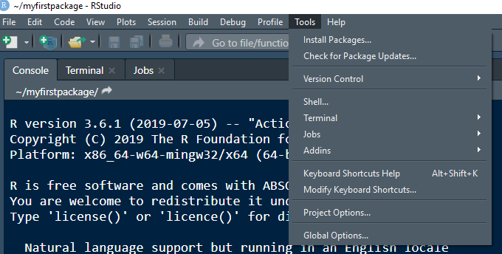
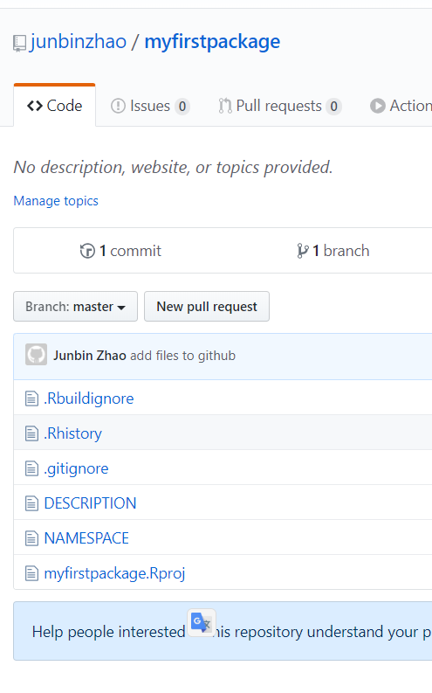

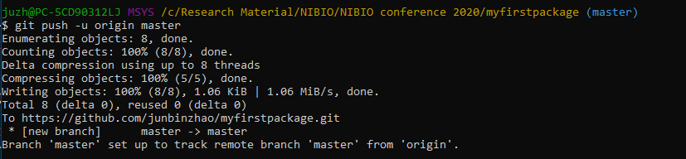
On Github:
Notes:
Run “git init” first?

Slide 12
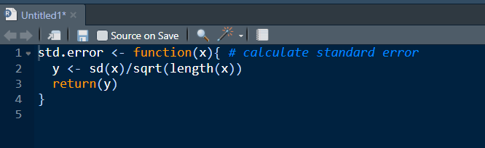
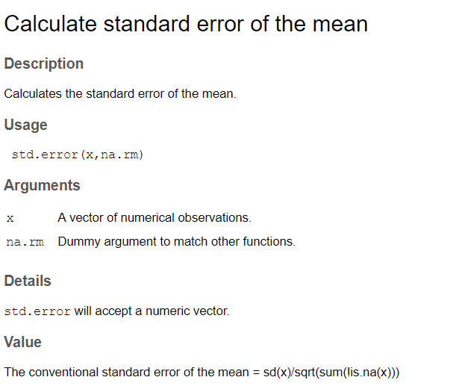
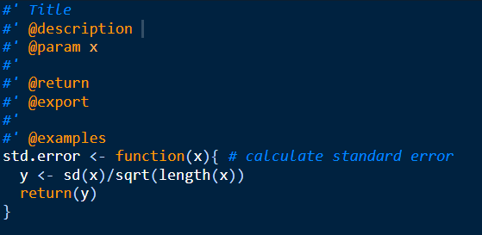
Step 3: add function
Create a new script, copy in your function
Code -> Insert Roxygen Skeleton (CTRL+ALT+SHIFT+R)

Slide 13
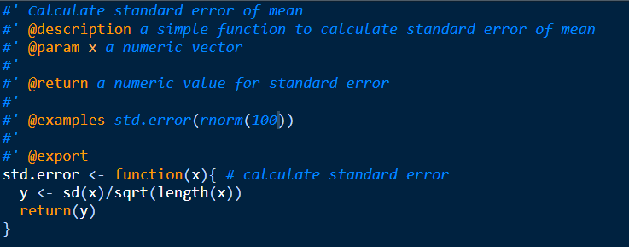
Step 4: add documentation (the help files)
Save the script to the “R” folder
Run -> a new “man” folder with help files ready!

Slide 14
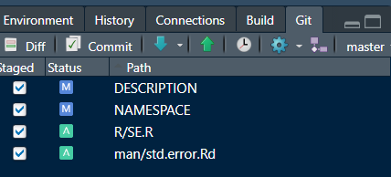
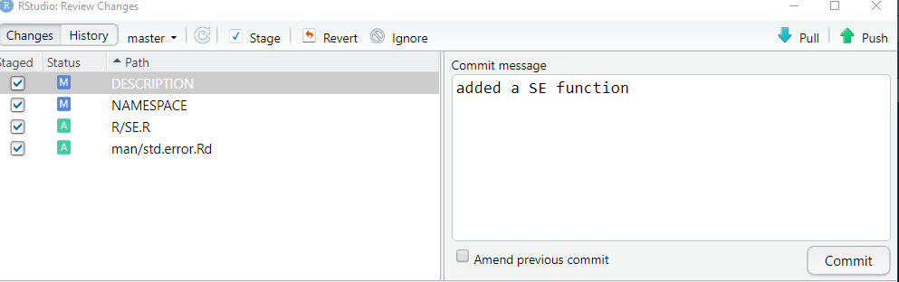
Step 5: Synchronize to github
*Commit = Sync

Slide 15
Use and share
Installation:
Share: (github repository link)

Slide 16
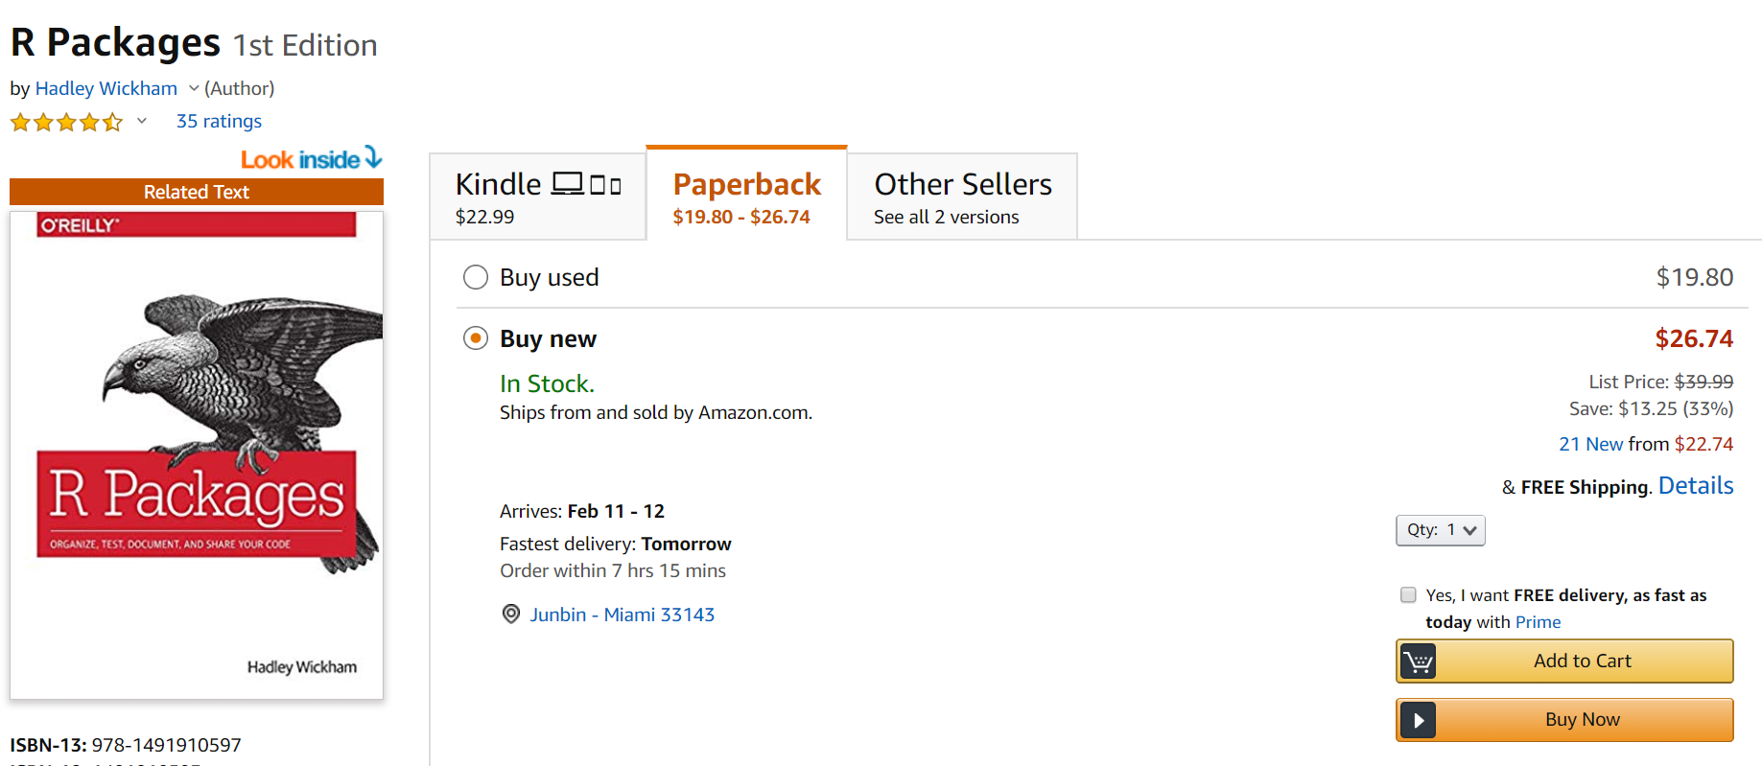

Web version: http://r-pkgs.had.co.nz/

Slide 17
So what?
Value of R as an open source software.
User vs developer!
Milestones of your R journey!
Something to brag about
Write it to your CV
Publication! (e.g. Journal of Open Source Software, only one page summary)

Slide 18

A little more efforts but A LOT more rewards!

